Slide 1
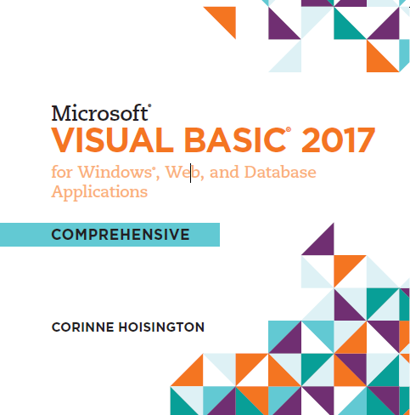

Microsoft Visual Basic 2017 for Windows®, Web, and Database Applications
Chapter 5 Decision Structures
Copyright © 2016 Cengage Learning®. May not be scanned, copied or duplicated, or posted to a publicly accessible website, in whole or in part.

Slide 2
Objectives (1 of 2)
Use the GroupBox object
Place RadioButton objects in applications
Display a message box
Make decisions using If…Then statements
Make decisions using If…Then…Else statements
Make decisions using nested If statements

Slide 3
Objectives (2 of 2)
Make decisions using logical operators
Make decisions using Case statements
Insert code snippets
Test input to ensure a value is numeric

Slide 4
User Interface Design
The user interface for the Decking Cost Calculator application includes three new objects:
GroupBox
RadioButtons
Message Boxes

Slide 5
Use the GroupBox Object (1 of 2)
Drag the GroupBox object to the desired location on the Form object
When the pointer is in the correct location, release the object. With the GroupBox object selected, scroll in the Properties window to the (Name) property. Double-tap or double-click in the right column of the (Name) property, and then enter the desired name. Double-tap or double-click in the right column of the Text property to change the caption of the GroupBox object. Enter the desired text. Tap or click to the right of the Size property of the GroupBox object and enter the deisired size
Change the Font property to the Goudy Old style,Regular,14 points

Slide 6
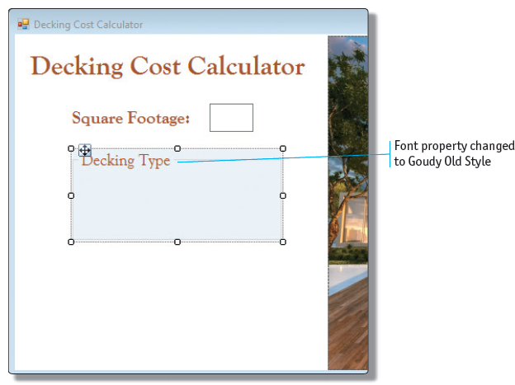
Use the GroupBox Object (2 of 2)

Slide 7
Add the RadioButton Objects (1 of 3)
Drag one RadioButton object from the Toolbox to the GroupBox object. Drag a second RadioButton object from the Toolbox into the GroupBox object, and use blue snap lines to align and separate the RadioButton objects vertically
Release the RadioButton object to place it within the GroupBox object. Using the same technique, add a third RadioButton object

Slide 8
Add the RadioButton Objects (2 of 3)
Name the RadioButton objects by selecting them one at a time, double-tapping or double-clicking on the right column of the (Name) property in the Properties window, and entering the name
Change the Text property for each RadioButton object by double-tapping or double-clicking the right column of the Text property and typing the desired values

Slide 9
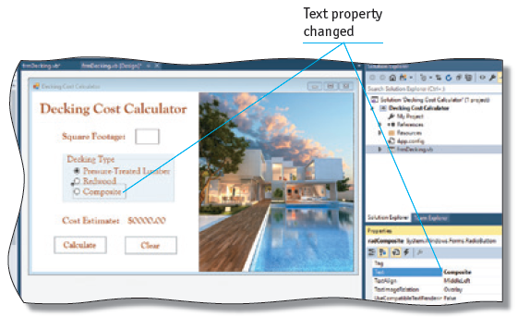
Add the RadioButton Objects (3 of 3)

Slide 10
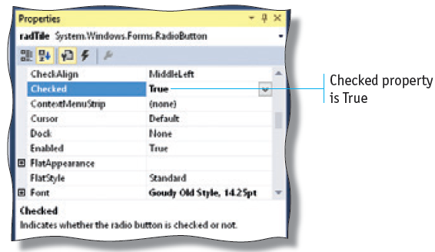
Use the Checked Property of RadioButton Objects
The RadioButton Object in the Decking Cost Calculator application allow the user to select one decking type

Slide 11
Windows Application Container Objects (1 of 2)
The Panel Object in a Windows Application works like a GroupBox object
Option | GroupBox Object | Panel Object
Have a caption | Yes | No
Have scroll bars | Yes | No
Display a labeled border | Yes | No

Slide 12
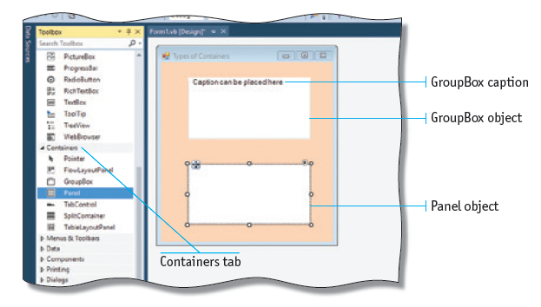
Windows Application Container Object (2 of 2)

Slide 13
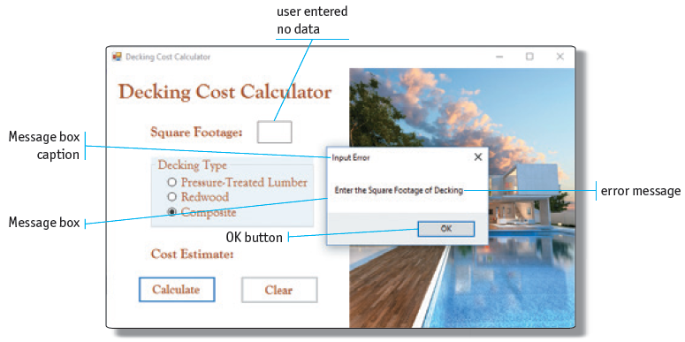
Display a Message Box (1 of 4)

Slide 14
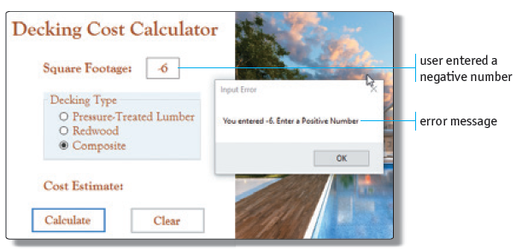
Display a Message Box (2 of 4)

Slide 15
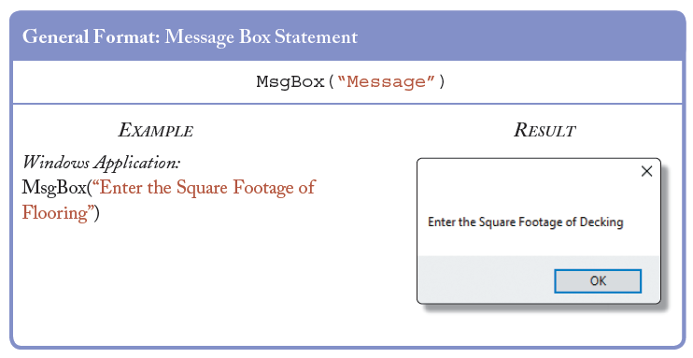
Display a Message Box (3 of 4)

Slide 16
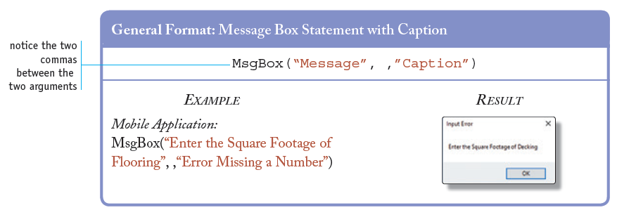
Display a Message Box (4 of 4)

Slide 17
Display Message Box Caption
A message box can be displayed during execution with a variety of arguments
In many applications, the caption is used to give further information to the user

Slide 18
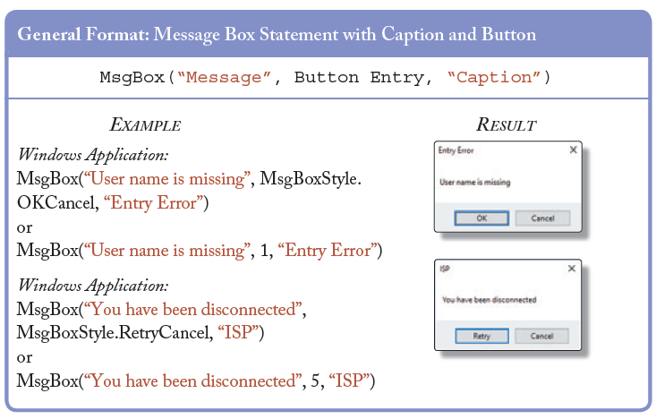
Message Box Buttons (1 of 2)

Slide 19
Message Box Buttons (2 of 2)
MsgBoxButtons Arguments | Value | Use
MsgBoxStyle.OKOnly | 0 | Displays an OK button — default setting
MsgBoxStyle.OKCancel | 1 | Displays an OK and Cancel button
MsgBoxStyle.AbortRetryIgnore | 2 | After a failing situation, the user can choose to Abort, Retry, or Ignore
MsgBoxStyle.YesNoCancel | 3 | Displays Yes, No, and Cancel buttons
MsgBoxStyle.YesNo | 4 | Displays Yes and No buttons
MsgBoxStyle.RetryCancel | 5 | After an error occurs, the user can choose to Retry or Cancel

Slide 20
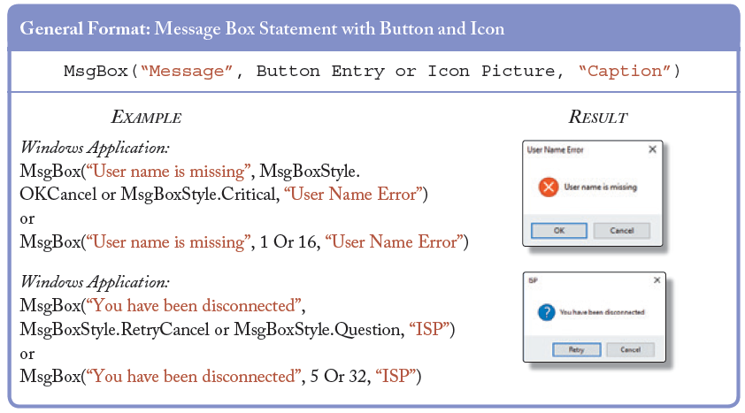
Message Box Icons (1 of 2)

Slide 21
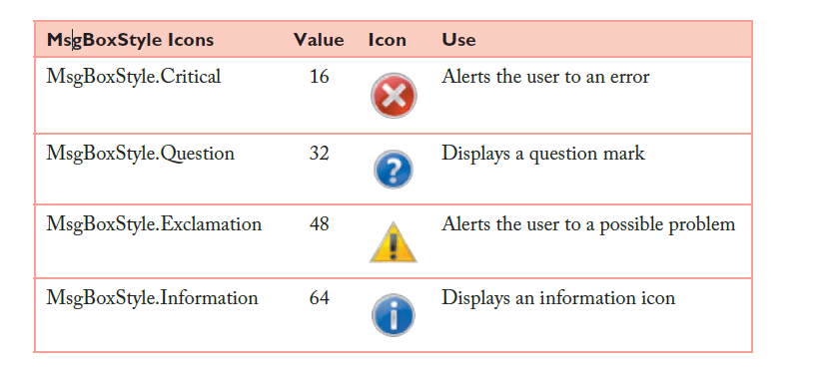
Message Box Icons (2 of 2)

Slide 22
Message Box IntelliSense (1 of 2)
In the code window, inside the event handler you are coding, type msg to display MsgBox in the IntelliSense list
Press the TAB key to select MsgBox in the IntelliSense list. Type the following text: (“You have been disconnected from the Internet”, m)
Select the MsgBoxStyle.AbortRetryIgnore argument by pressing the UP ARROW until the correct argument is highlighted. Type a comma. Then type "ISP” and a right parenthesis
Tap or click the Start Debugging button on the Standard toolbar

Slide 23
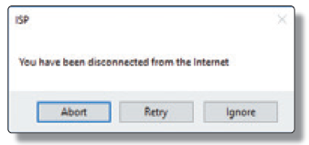
Message Box IntelliSense (2 of 2)

Slide 24
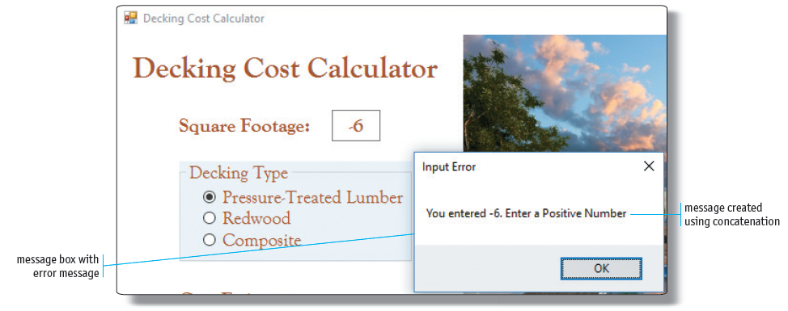
String Concatenation
To create the message in the message box, you can use concatenation

Slide 25
Make Decisions with Conditional Statements
A decision structure is one of the three fundamental control structures used in computer programming
When a condition is tested in a Visual Basic program, the condition either is true or false

Slide 26
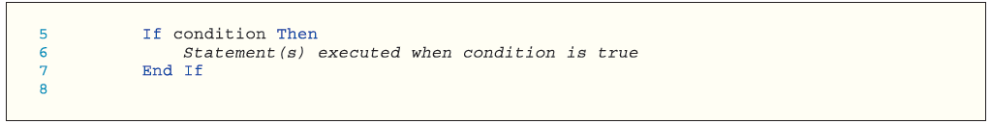
Using an If…Then Statement

Slide 27
Relational Operators (1 of 4)
the condition portion of the If . . . Then statement means a condition is tested to determine if it is true or false. The conditions that can be tested are as follows:
Is one value equal to another value?
Is one value not equal to another value?
Is one value greater than another value?
Is one value less than another value?
Is one value greater than or equal to another value?
Is one value less than or equal to another value?

Slide 28
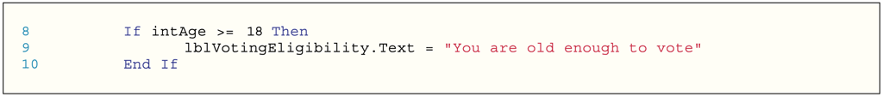
Relational Operators (2 of 4)
 | Relational Operator | Meaning | Example | Resulting Condition
1 | = | Equal to | 8 = 8 | True
2 | <> | Not equal to | 6 <> 6 | False
3 | > | Greater than | 7 > 9 | False
4 | < | Less than | 4 < 6 | True
5 | > = | Greater than or equal to | 3 > = 3 | True
6 | < = | Less than or equal to | 7 < = 5 | False

Slide 29
Relational Operators (3 of 4)
With the insertion point located in the correct location in the code, type if and then press the SPACEBAR
Type int a to select the variable named intAge in the IntelliSense list. Then, type >=18 as the condition to be tested. Press the ENTER key
On the blank line, enter the statement that should be executed when the condition is true. To place the message, “You are old enough to vote” in the Text property of the lblVotingEligibility Label object, insert the code shown in Figure. Use IntelliSense to reference the lblVotingEligibility Label object

Slide 30
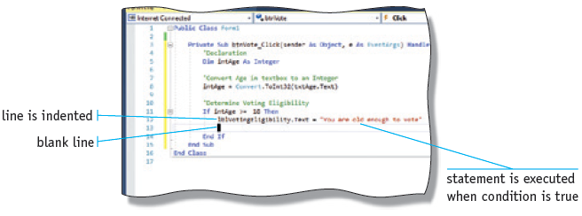
Relational Operators (4 of 4)

Slide 31
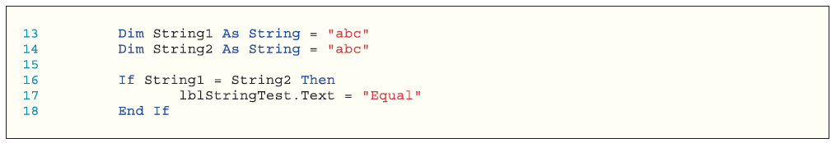
Compare Strings

Slide 32
Comparing Different Data Types
Every type of data available in Visual Basic can be compared
Different numeric types can be compared to each other
A single string character can be compared to a Char data type

Slide 33
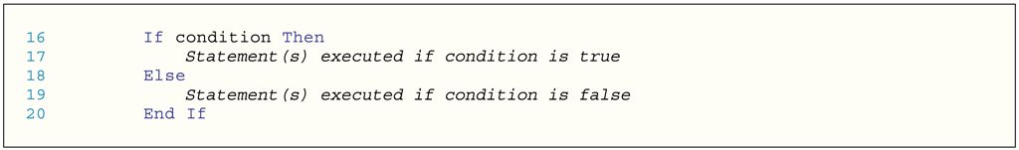
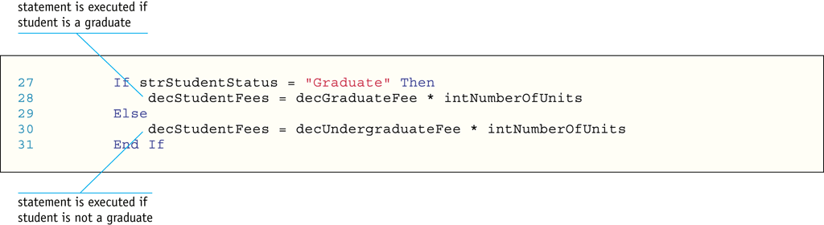
Use the If…Then…Else Statement

Slide 34
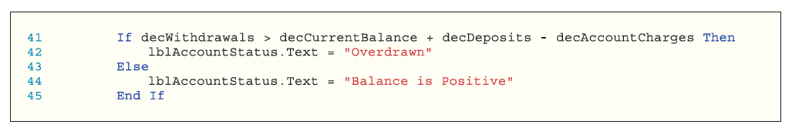
Compare to an Arithmetic Expression

Slide 35
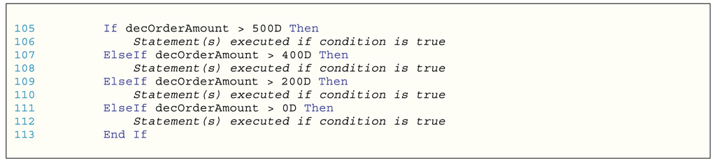
Use the If…Then…ElseIf Statement

Slide 36
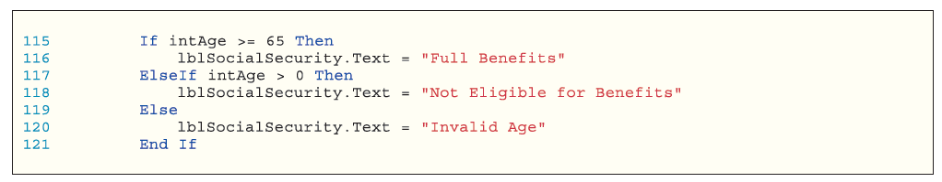
Trailing Else Statements

Slide 37
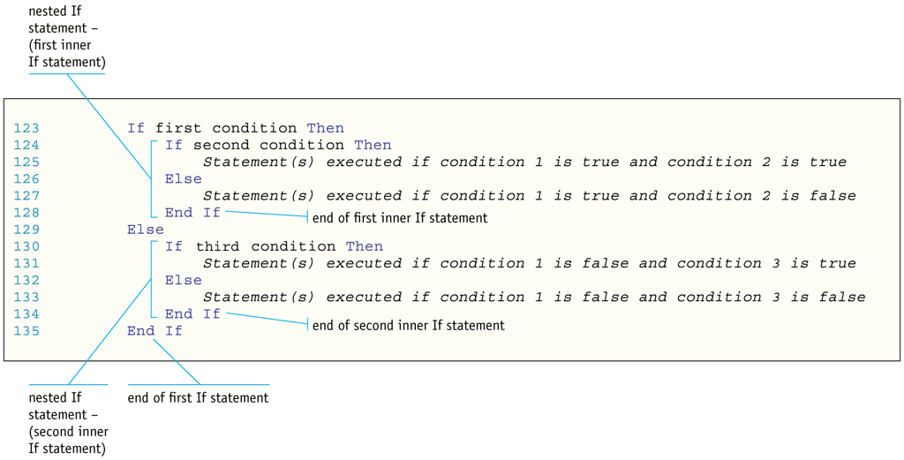
Nested If Statements (1 of 2)

Slide 38
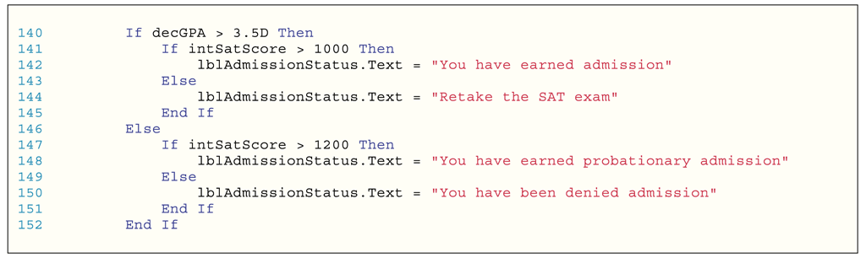
Nested If Statements (2 of 2)

Slide 39
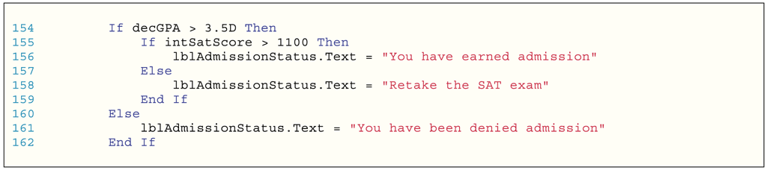
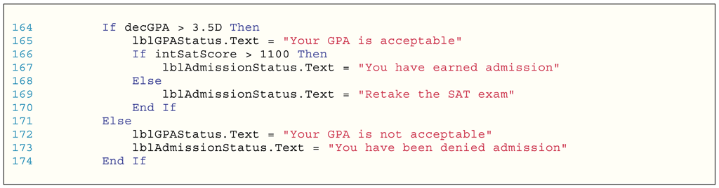
Other Nested If Statements

Slide 40
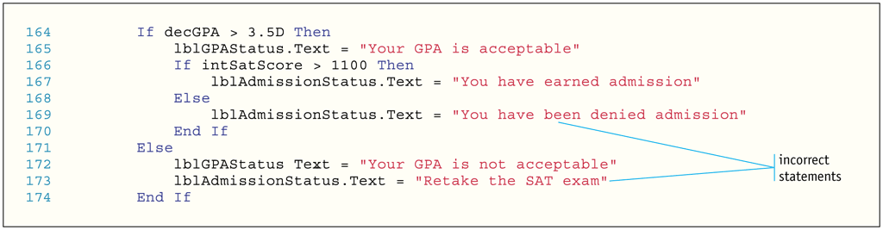
Matching If, Else, and End If Entries
If statements must be fully contained within the outer If statement
Place the correct executing statements with the If and Else statements within the nested If statement
This illustration shows incorrect logic

Slide 41

Test the Status of a RadioButton Object in Code

Slide 42
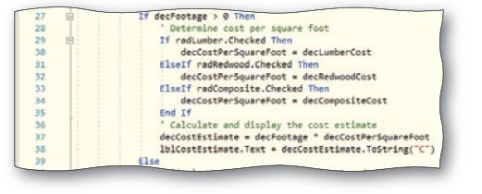
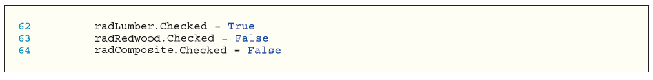
Test Radio Buttons with the If . . . Then . . . ElseIf Statement

Slide 43
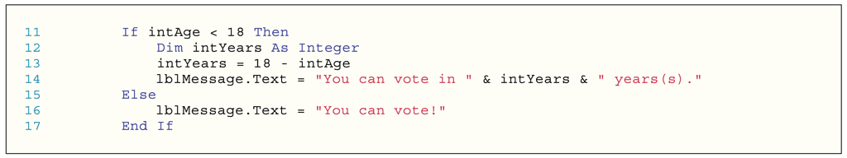
Block-Level Scope
Scope is defined by where the variable is declared within a program
Within an event handler, an If…Then…Else statement is considered a block of code
Variables can be declared within a block of code
The variable can be referenced only within the block of code where it is declared

Slide 44
Use Logical Operators
When more than one condition is included in an If...Then...Else statement, the conditions are called a compound condition
Logical Operator | Meaning
And | All conditions tested in the If statement must be true
Or | One condition tested in the If statement must be true
Not | Negates a condition

Slide 45
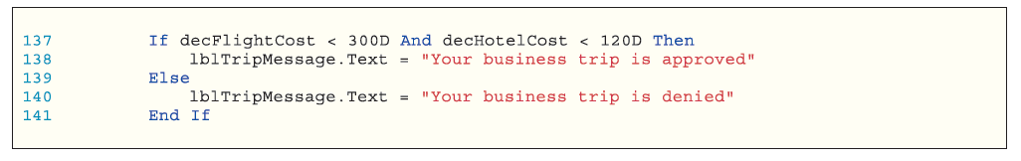
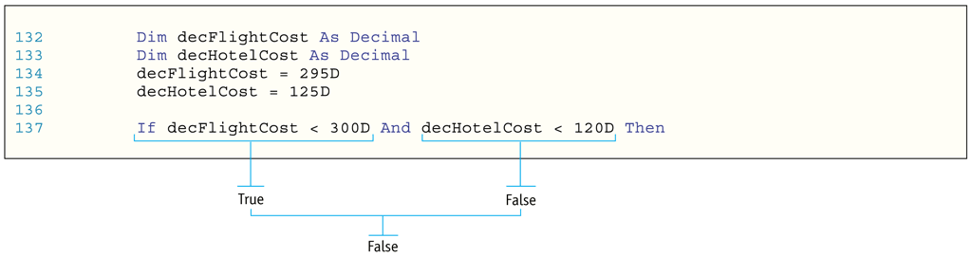
Use the And Logical Operator
The And logical operator allows you to combine two or more conditions into a compound condition that can be tested with an If statement.

Slide 46
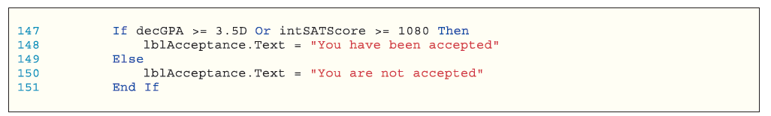
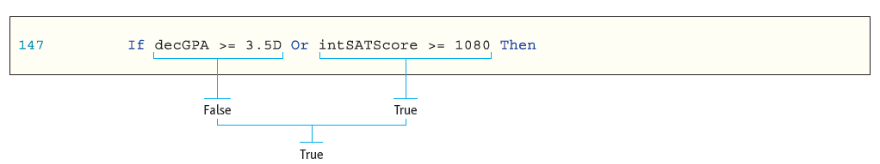
Use the Or Logical Operator
When the Or logical operator is used to connect two or more conditions, the compound condition is true if any tested condition is true.

Slide 47
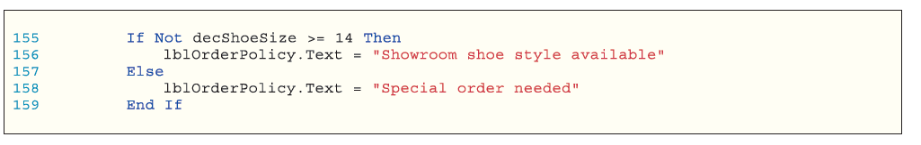
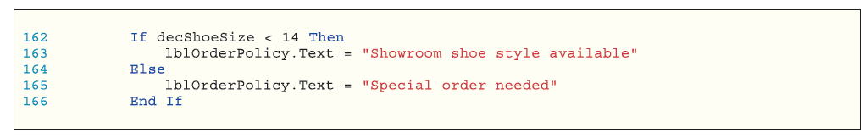
Use the Not Logical Operator
The Not logical operator allows you to state conditions that are best expressed in a negative way.

Slide 48
Other Logical Operators
Logical Operator | Meaning
Xor | When one condition in the compound condition is true, but not both, the compound condition is true
AndAlso | As soon as a condition is found to be false, no further conditions are tested and the compound condition is false
OrElse | As soon as a condition is found to be true, no further conditions are tested and the compound condition is true

Slide 49
Order of Operations for Logical Operators
Logical Operator | Order
Not | Highest Precedence
And, AndAlso | Next Precedence
Or, OrElse, Xor | Last Precedence

Slide 50
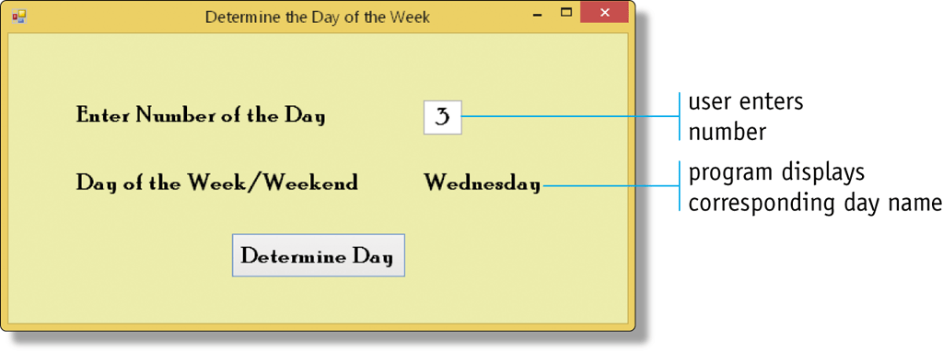
Select Case Statement (1 of 2)
In some programming applications, different operations can occur based on the value in a single field

Slide 51
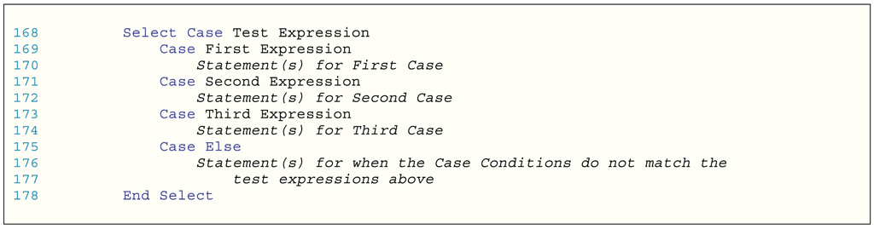
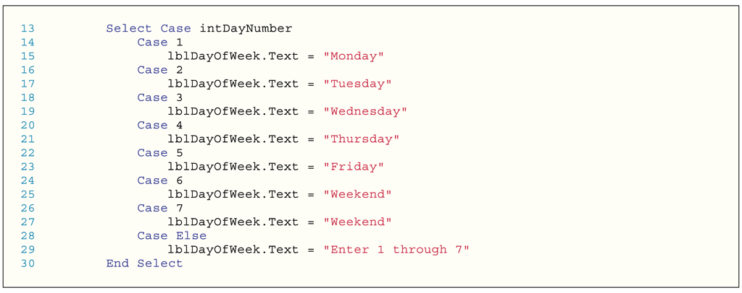
Select Case Statement (2 of 2)

Slide 52
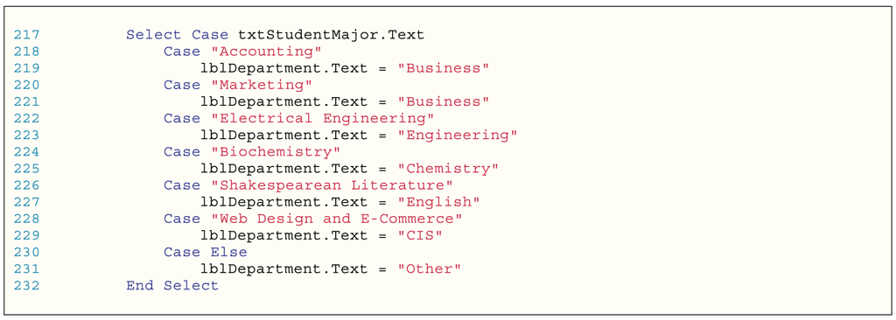
Select Case Test Expressions

Slide 53
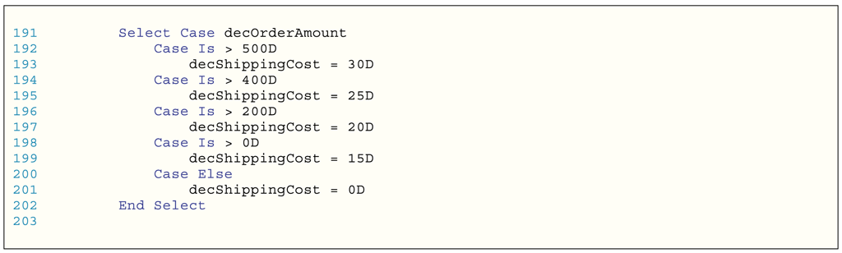
Use Relational Operators in a Select Case Statement

Slide 54
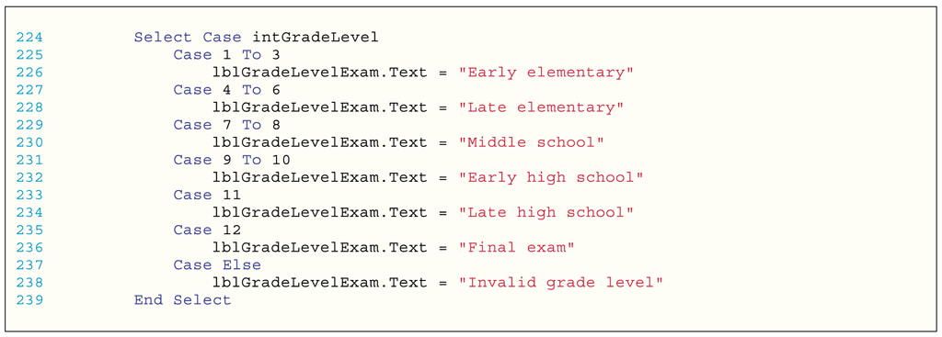
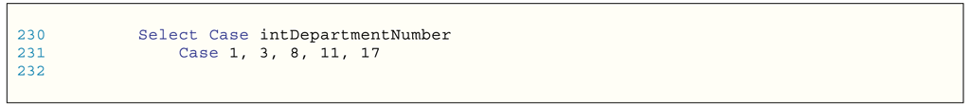
Use Ranges in Select Case Statements

Slide 55
Select Which Decision Structure to Use
You might need to determine if you should use the Select Case statement or the If...Then...ElseIf statement to solve a problem
Generally, the Select Case statement is most useful when more than two or three values must be tested for a given variable
The If...Then...ElseIf statement is more flexible
More than one variable can be used in the comparison
Compound conditions with the And, Or, and Not logical operators can be used

Slide 56
Use Code Snippets
Press and hold or right-click the line in the code window where you want to insert the snippet
Tap or click Insert Snippet on the shortcut menu
Double-tap or double-click the folder Code Patterns - If, For Each,Try Catch, Property, etc, which contains commonly used code such as the If . . . Then . . . Else statement
Double-tap or double-click the Conditionals and Loops folder because an If...Then...Else statement is a conditional statement
Double-tap or double-click the If...Else...End If Statement code snippet

Slide 57
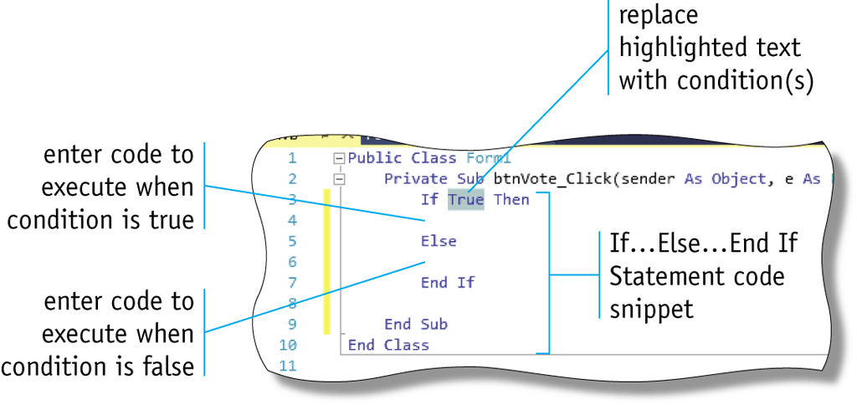
Code Snippets

Slide 58
Validate Data
Developers should anticipate that users will enter invalid data
Developers must write code that will prevent the invalid data from being used in the program to produce invalid output

Slide 59
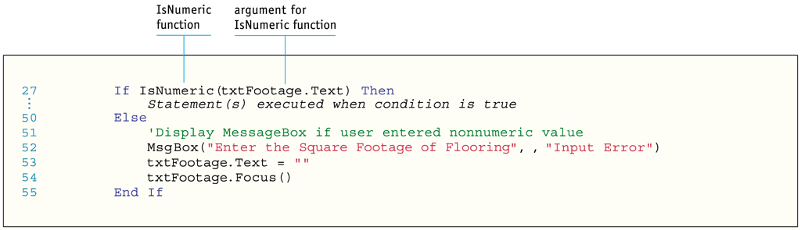
Test Input to Determine If the Value Is Numeric
The Visual Basic IsNumeric function can check the input value to determine if the value can be converted into a numeric value such as an Integer or Decimal data type

Slide 60
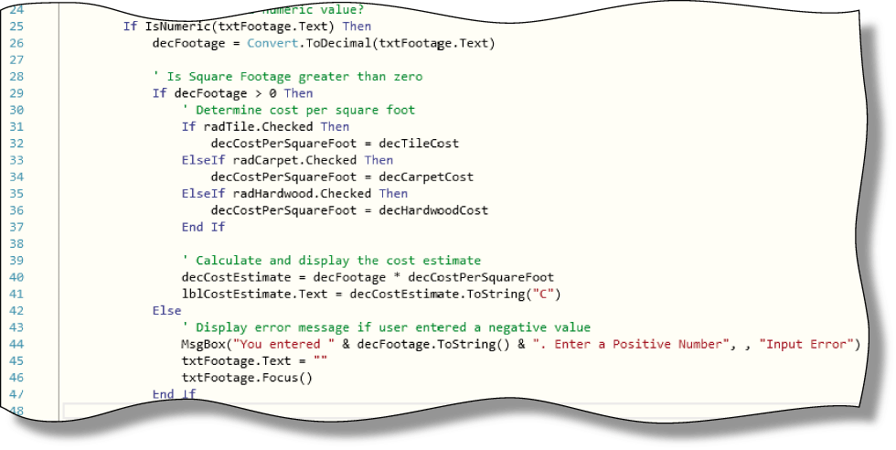
Checking for a Positive Number

Slide 61
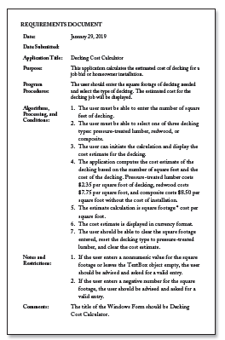
Program Design (1 of 2)

Slide 62
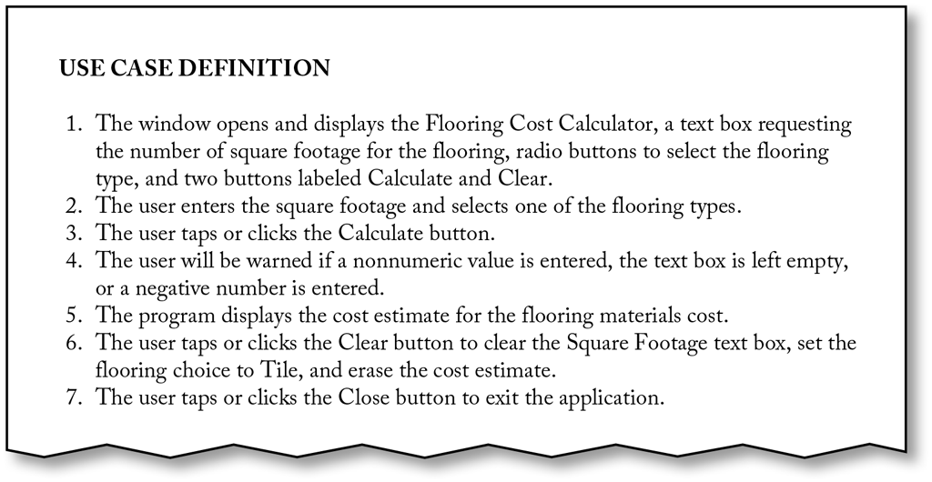
Program Design (2 of 2)

Slide 63
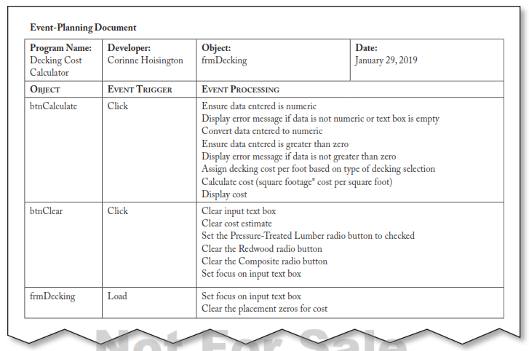
Event-Planning Document

Slide 64
Summary
Understand and learned to make decisions based on the user’s input.

